Slide 1
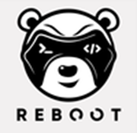
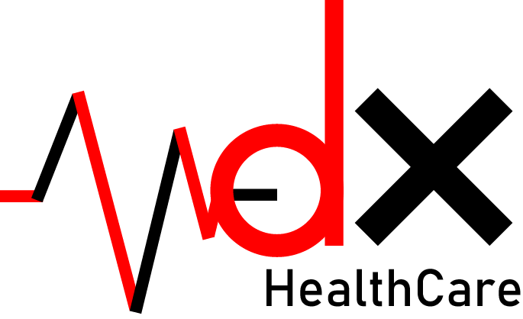

Slide 2
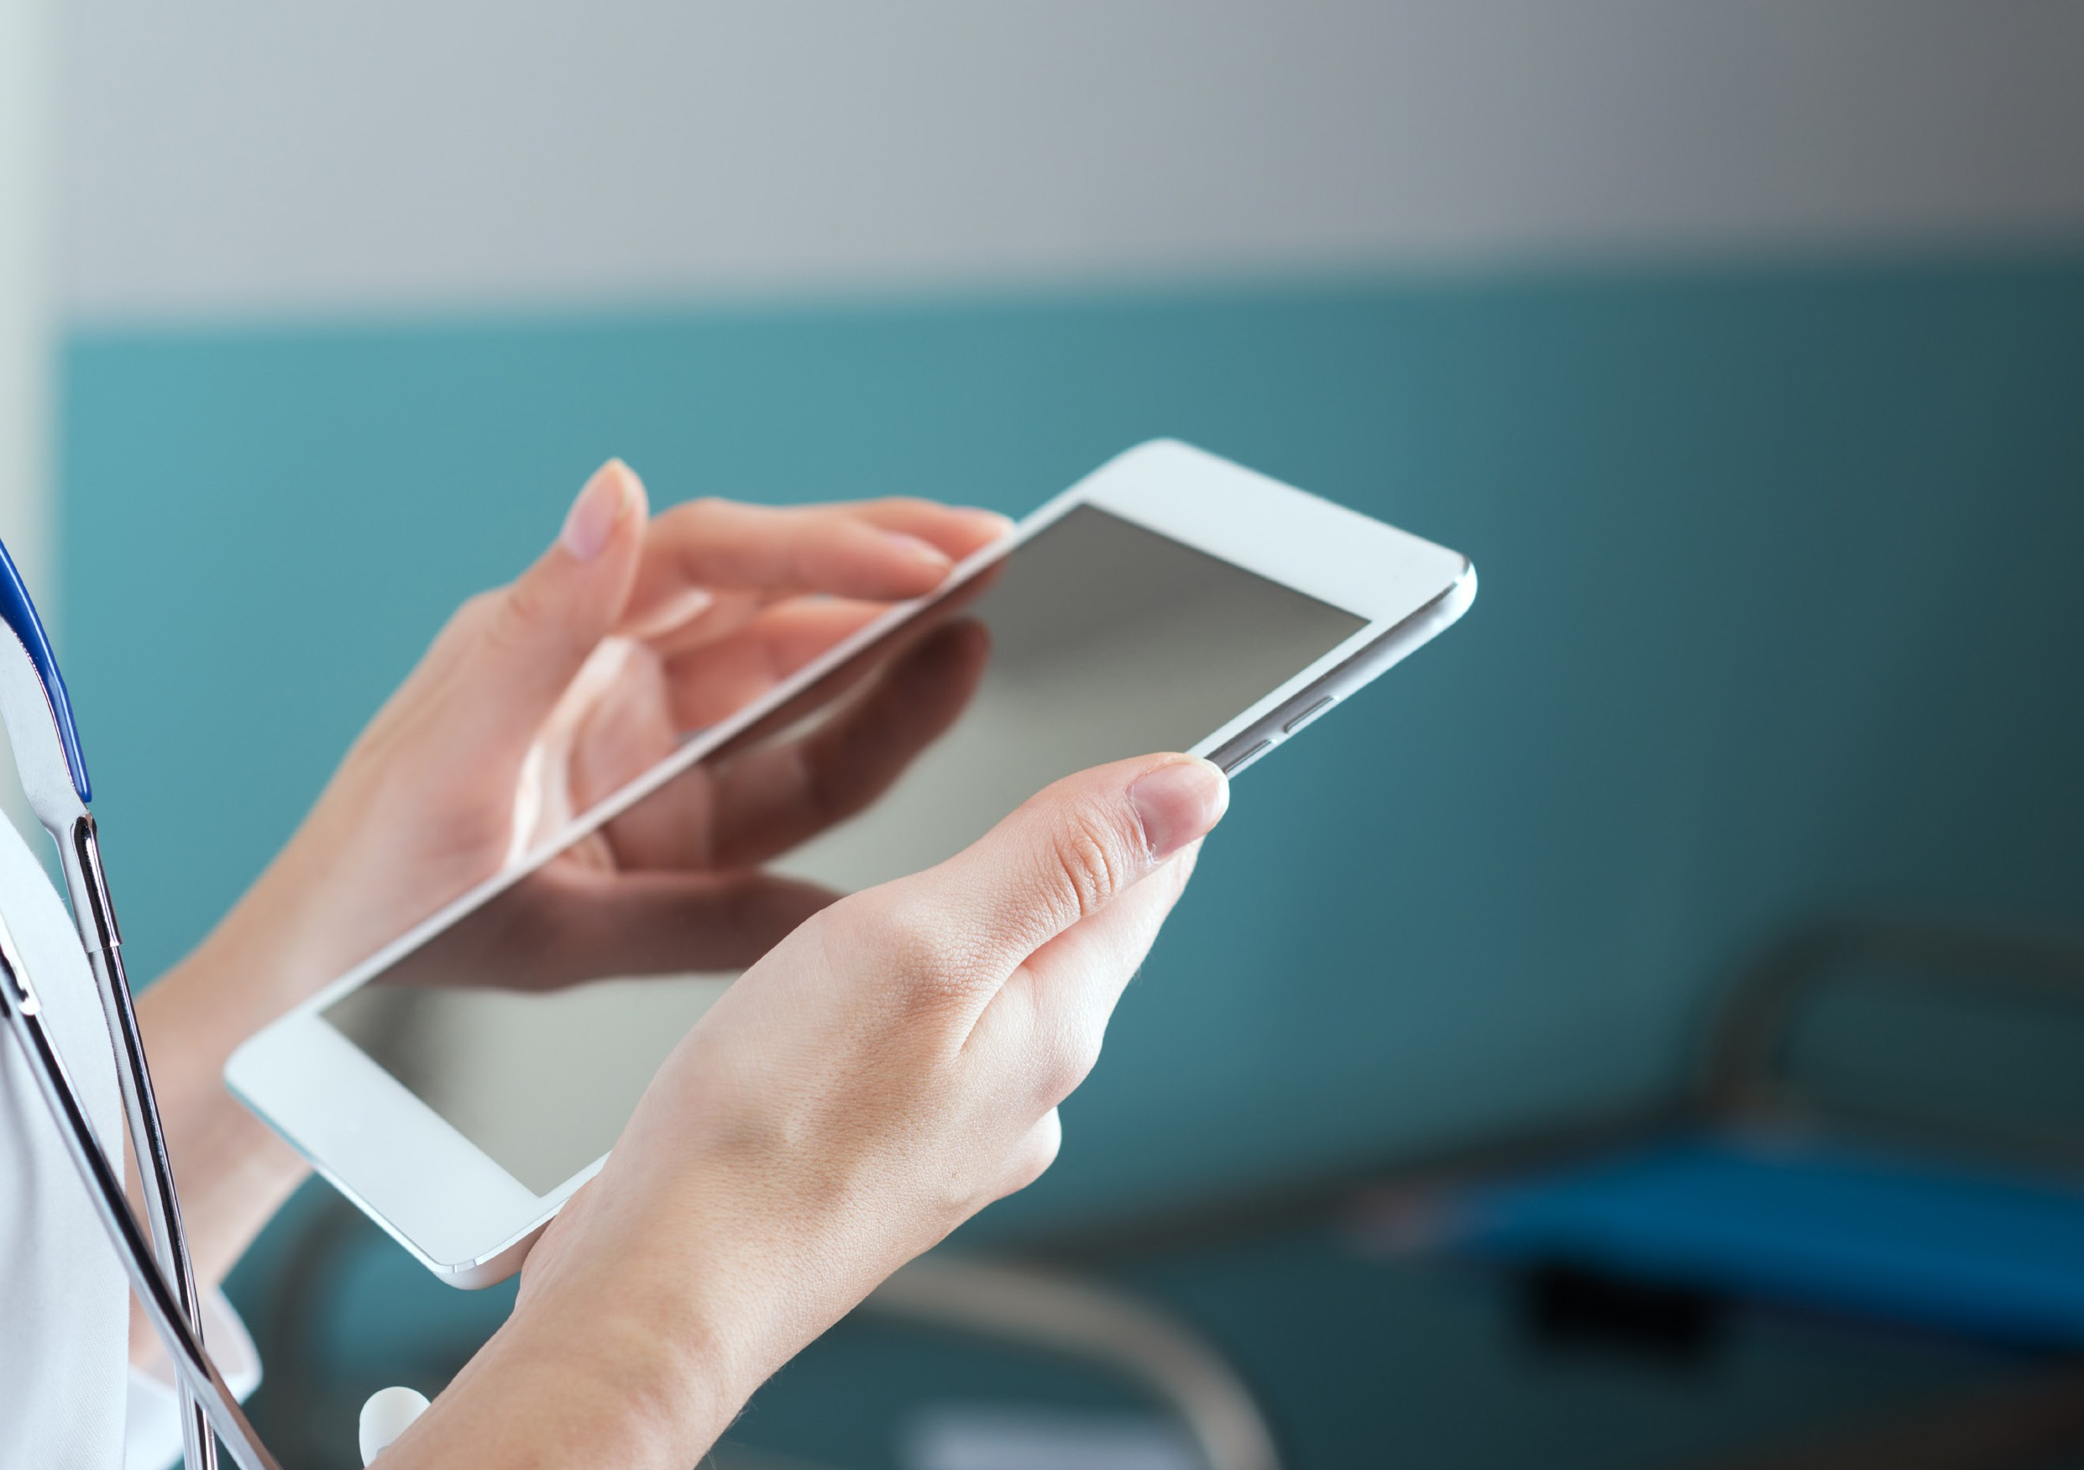

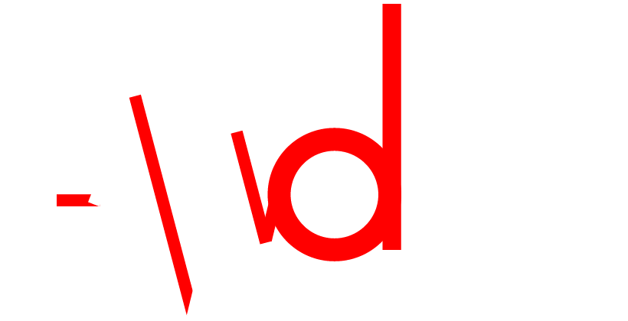














Remote Health-Monitoring System with auto-diagnosis feature
using IoT, Data Science and Block chain

Slide 3
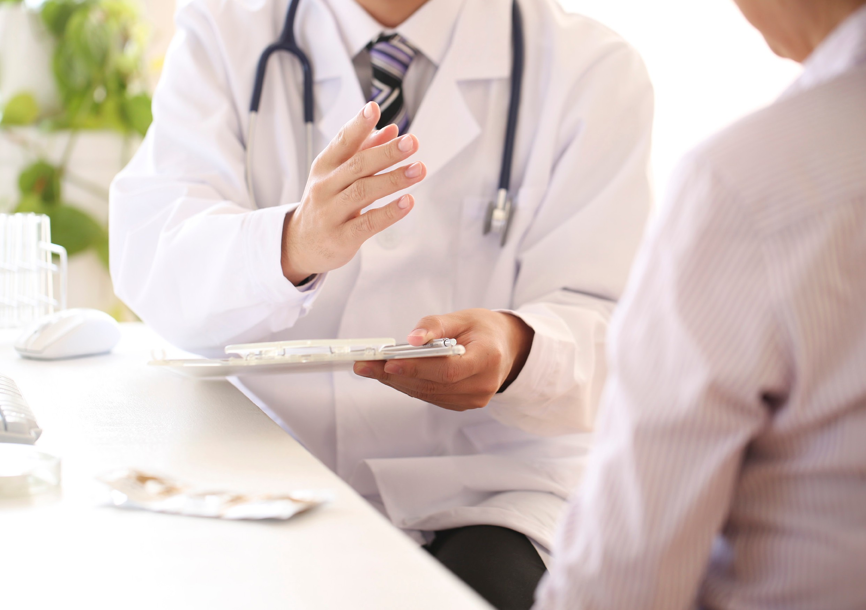

Slide 4
A Tsunami of Information
15 minutes.
That’s how long your doctor has to see you, assess your complaint, diagnose a solution and see you out the door – hopefully on the pathway back to wellness.
A huge data file is required to enable the practice of precision medicine. Revolution in healthcare.
It is the ability to target healthcare treatment specifically for an individual.

Slide 5
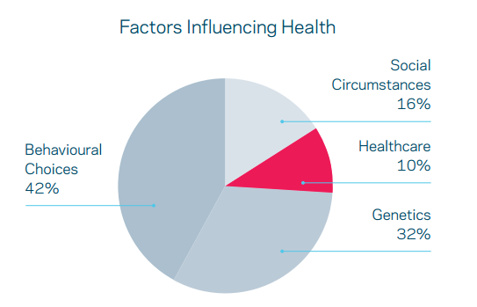
There are two things required for the successful application of machine learning in healthcare – intelligent algorithms and rich data sets.

Slide 6

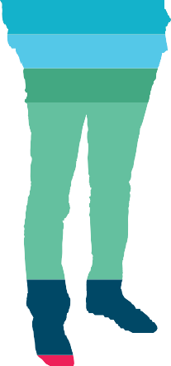
Data useful for the practice of precision medicine
Social Data
Personal circumstances, such as living situation and income
Exposome
Impact of the external environment, such as pollution
and tobacco smoke etc
Device Data
Information collected from apps that measure fitness and sleeping, electronic inhalers etc
Microbiome
Collective name for 100 trillion microscopic
bugs living inside us
Metabolome
Chemicals which are created, modified and broken down by bodily processes such as enzymatic reactions
Proteome System of proteins, including enzymes, which are the building blocks of the body
Transcriptome
Messages created from DNA to form the template (mRNA) of proteins
Epigenetic (Methylome) The set of nucleric and methylation modifications in a human genome
Genome
Patient's complete set of genes 'written' in DNA
Imaging
Medical images, such as x-rays, scans, ultrasound
Clinical Data
Patient's medical record

Slide 7
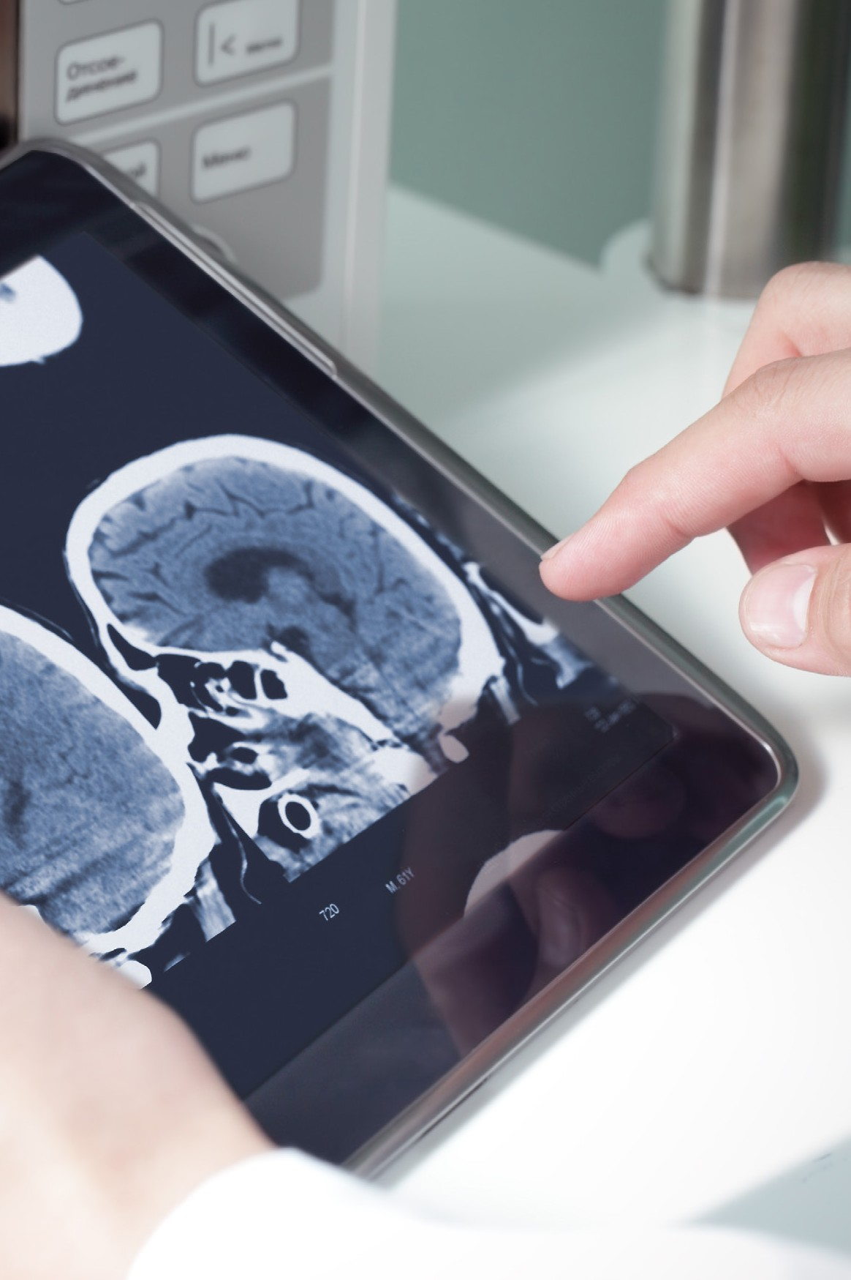

Idea
Based on Machine-to-Machine (M2M) technology, we propose a system to remotely monitor health of patients. The system gathers all information regarding current health condition of the patient and automatically diagnoses the data to suggest medication to the patient. To provide surety to the patient, the same report is sent to the hospital where any of the doctors verifies the medication report.

Slide 9
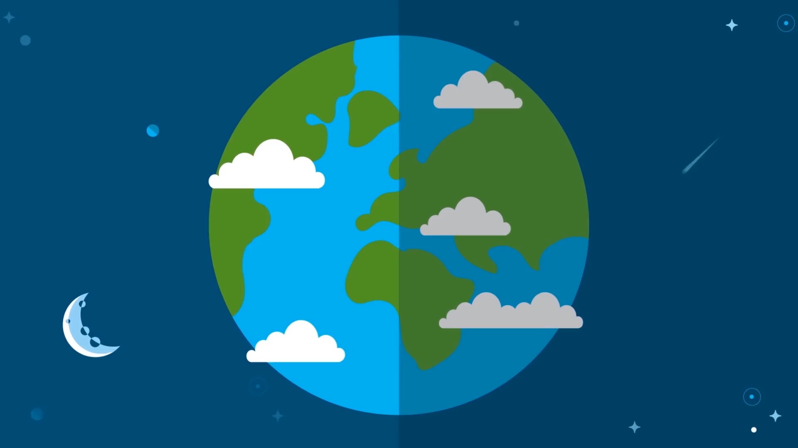

Slide 10
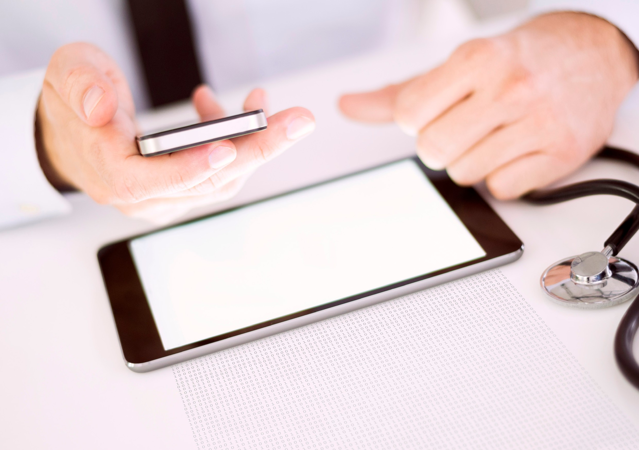
Objective
Gather cardiac data from various sensors.
Implement a Chat-Bot System to interview the patient.
Implement and predict among few ML algorithms which produce best result
for auto-diagnosis.
Send the final report for doctor’s verification (who is at far away place).

Slide 11
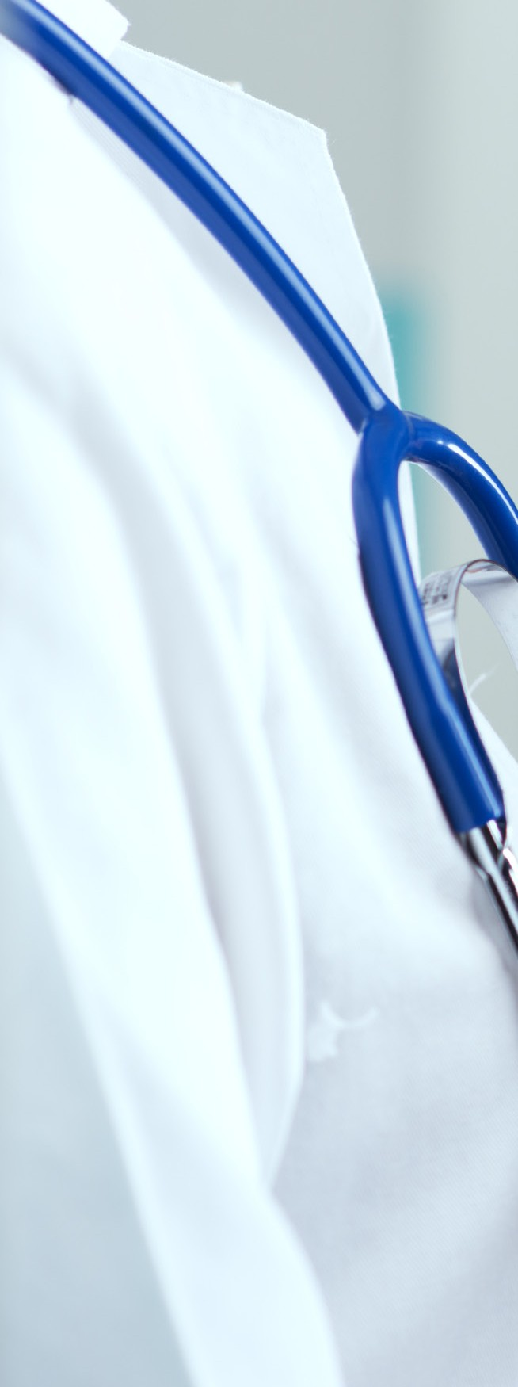
Technologies used
M2M Technology (IoT)
Data Science-
Natural Language Procecssing &
Machine Learning Algorithms
Blockchain

Slide 12
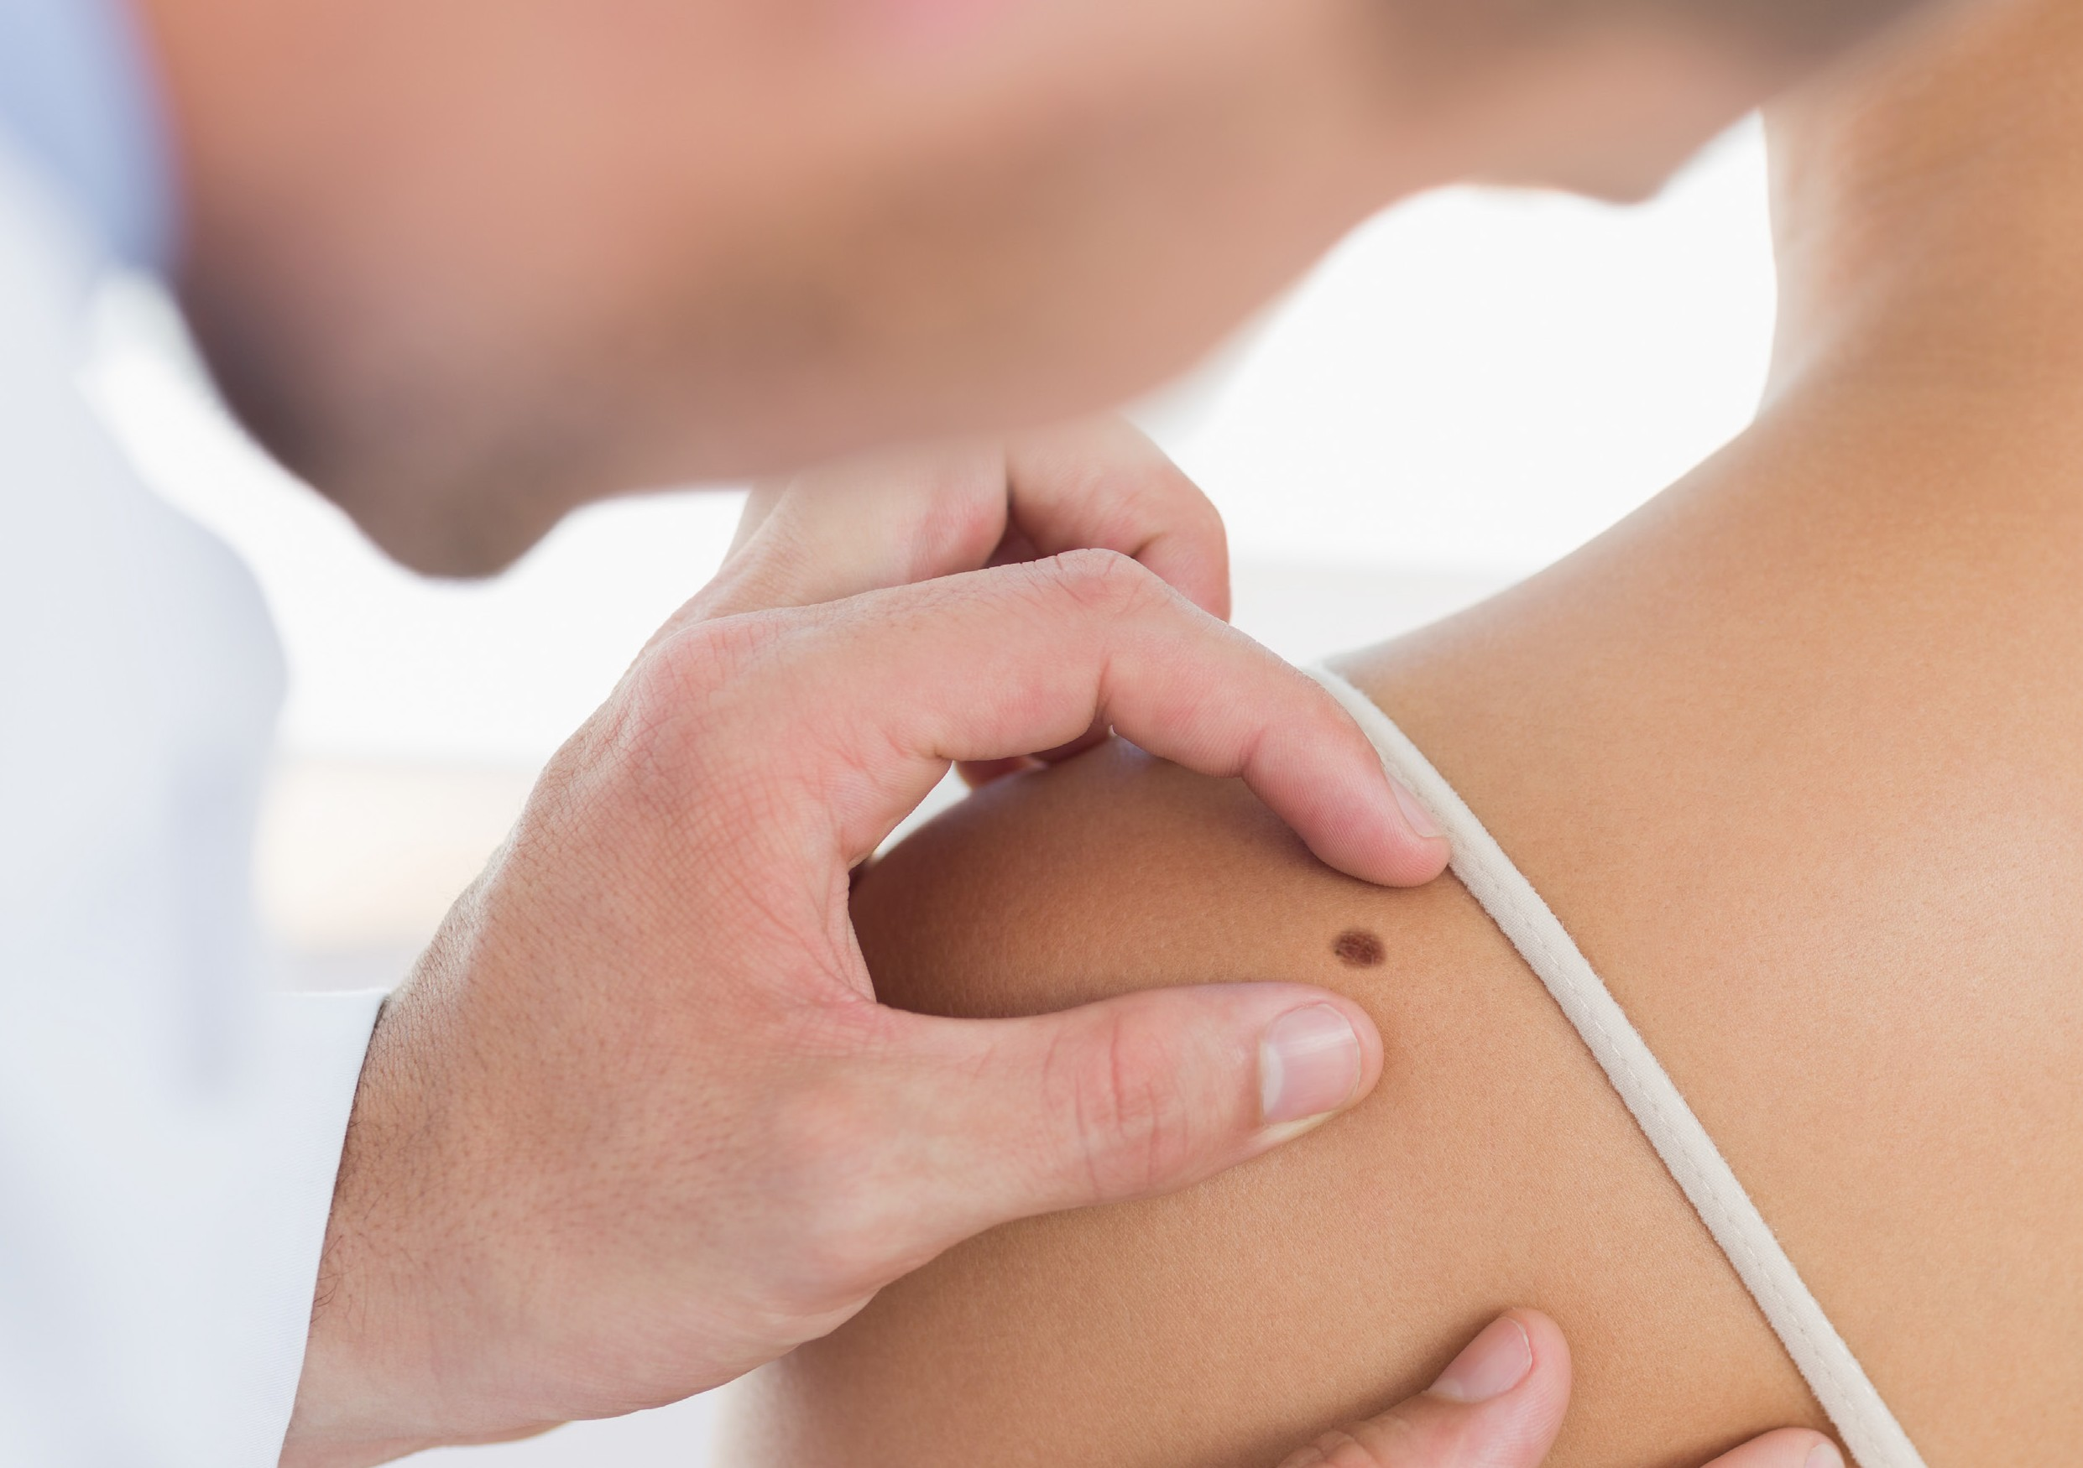
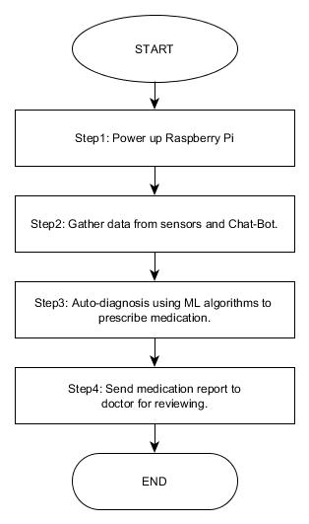
Methodology

Slide 13
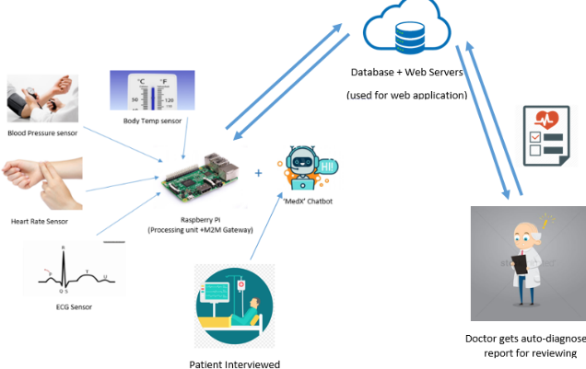

Slide 14
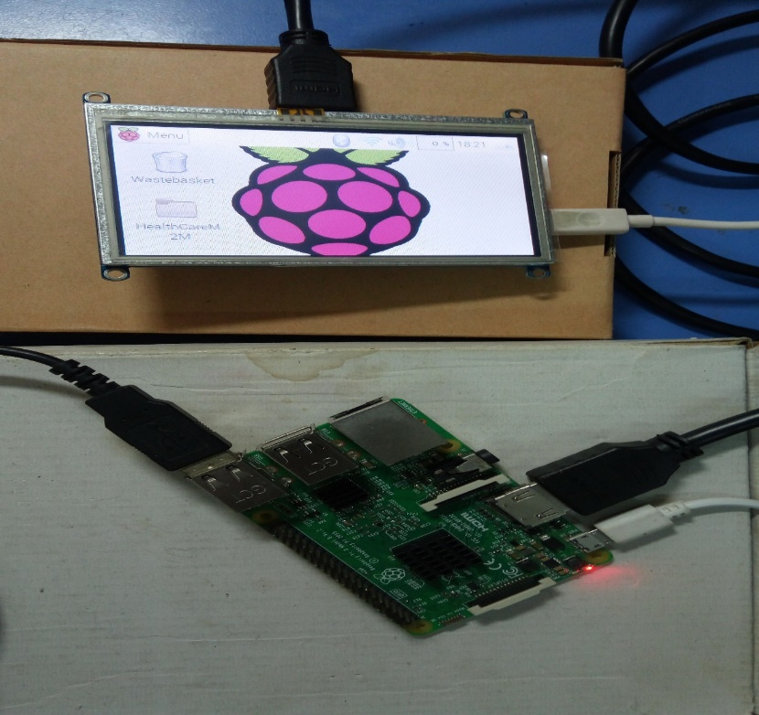
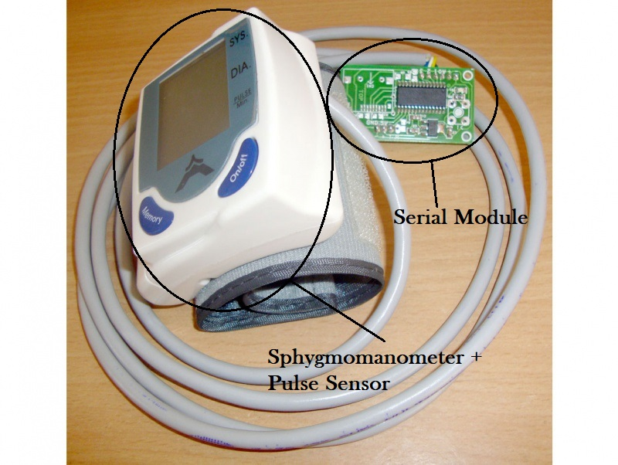
Hardware Pics

Slide 15
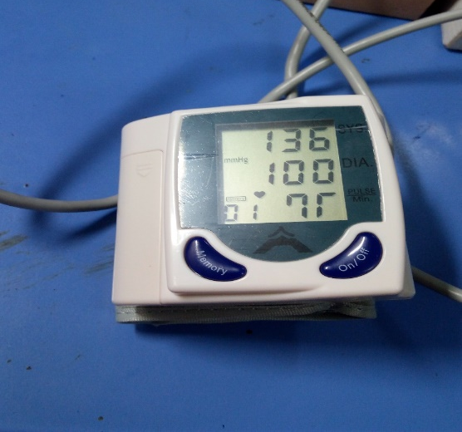
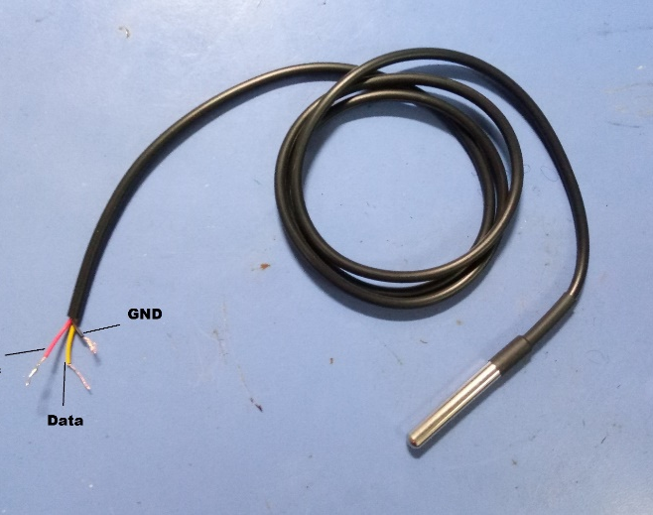
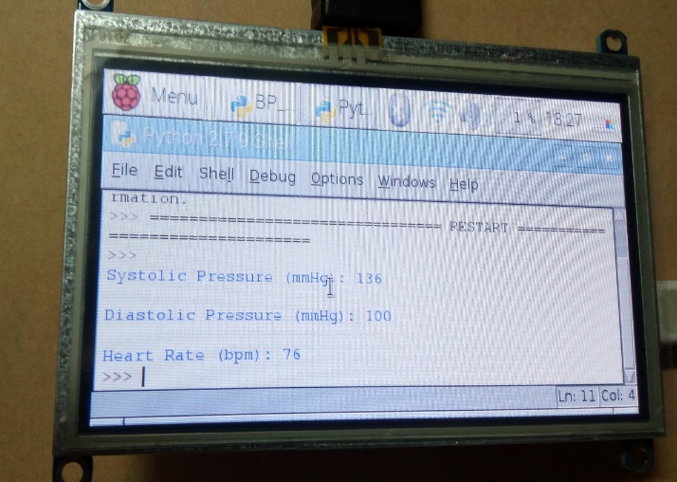

Slide 16
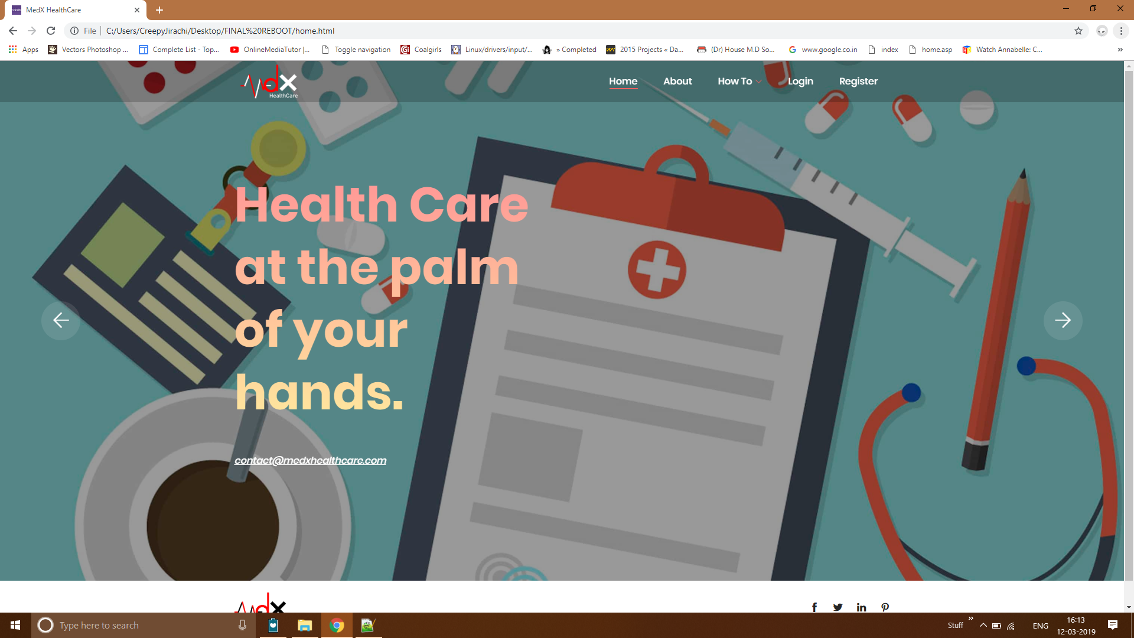
UI- Web App

Slide 17
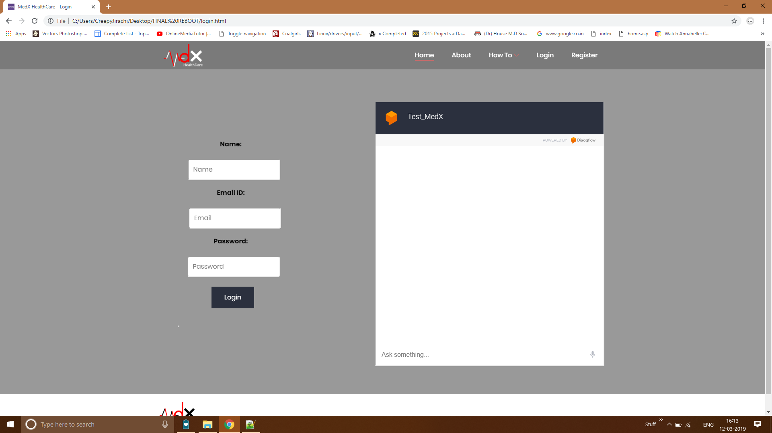

Slide 18
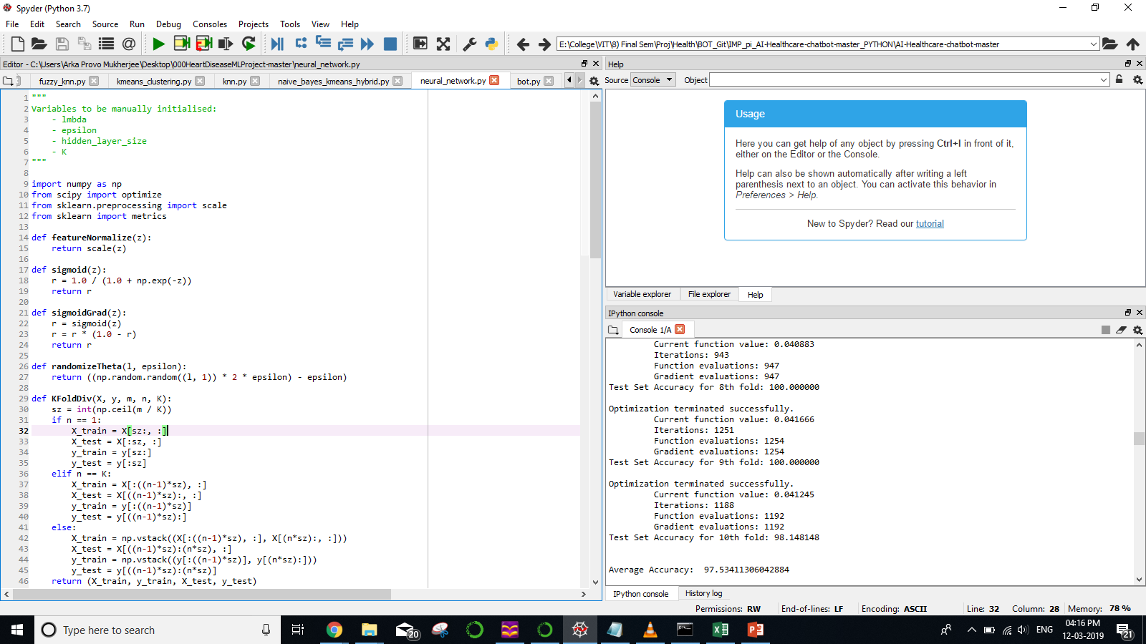
ML Models

Slide 19
